Slide 1

An Explainable Semantic Intelligence Framework for Early Prediction of Industrial Equipment Failures Using Unstructured Maintenance Narratives
DSA-0308 NATURAL LANGUAGE PROCCESSING
GUIDE NAME: DR. T. Kumaragurubaran
NIRMAL KASI (192424248)
HARIHARAN G (1924224156)
HARISSH M (192424014)
SIMATS Engineering, SIMATS
CAPSTONE PROJECT
1

Slide 2

Abstract
Industrial equipment failures can cause production downtime, repair costs, and safety risks.
Maintenance teams continuously record observations about machines in textual reports.
Consider centrifugal pump P-204, where technicians report vibration, noise, and temperature changes.
The proposed system uses NLP to understand these maintenance narratives.
BERT, BiLSTM, and RoBERTa analyze the information and predict possible failure.
The system aims to provide an early warning before major equipment breakdown.
CAPSTONE PROJECT
2

Slide 3
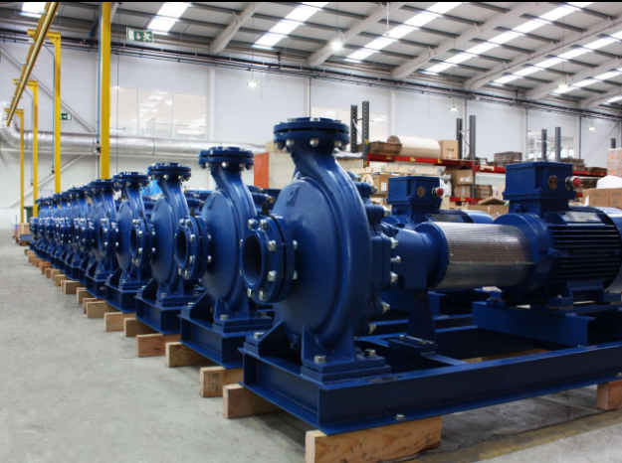
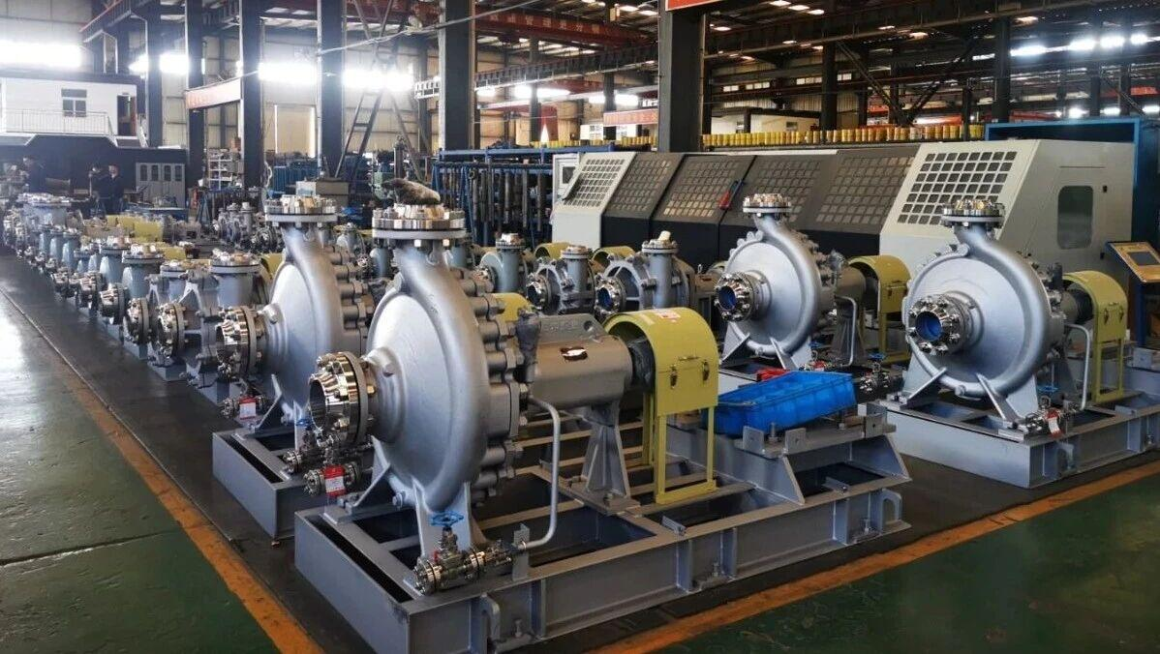
Introduction
Pump P-204 operates continuously in an industrial production line.
Technicians regularly record observations such as vibration, noise, and overheating.
These observations are usually stored as natural-language maintenance reports.
Traditional predictive systems mainly focus on structured sensor measurements.
NLP can extract useful information from these textual observations.
The project uses this information to identify developing failure patterns.
CAPSTONE PROJECT
3

Slide 4
Literature Survey
S.No | Details of the Journal / Paper | Algorithm / Methodology Used | Advantages | Disadvantages
1 | Semantic Analysis of Maintenance Logs for Failure Prediction (2022) | Natural Language Processing (NLP) | Extracts meaningful information from textual data | Requires extensive preprocessing
2 | Early Equipment Failure Prediction Using Machine Learning (2023) | Random Forest Algorithm | High prediction accuracy and robustness | Requires large training datasets
3 | Deep Learning for Industrial Maintenance Analytics (2023) | LSTM Neural Network | Captures sequential patterns in maintenance records | Computationally expensive
4 | Explainable AI for Predictive Maintenance Systems (2024) | SHAP and XAI Techniques | Provides transparent and interpretable predictions | Increased model complexity
5 | Semantic Intelligence Framework for Industrial Failure Detection (2025) | NLP with Explainable Machine Learning | Improves reliability and supports decision-making | Performance depends on data quality

Slide 5
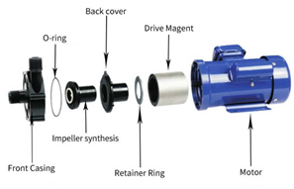
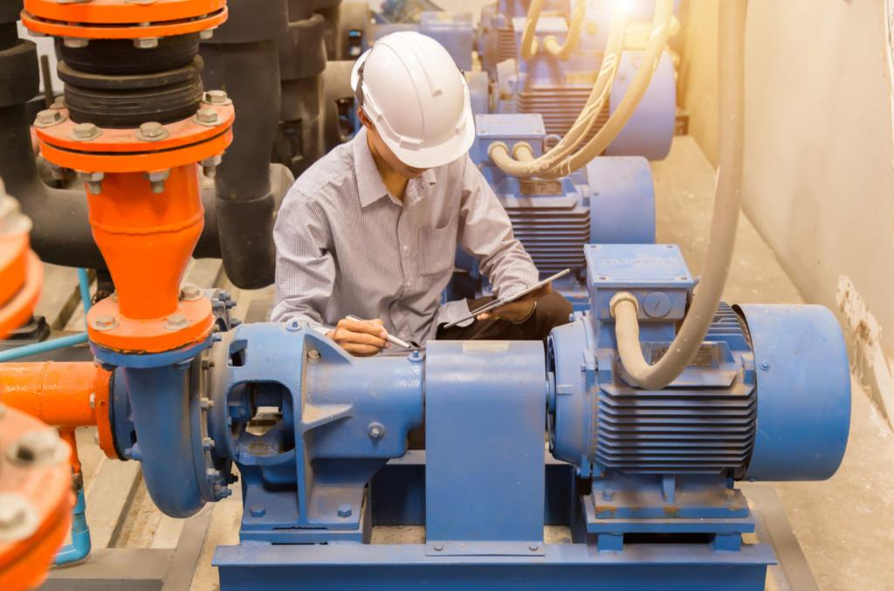
Objectives
Extract faults and machine conditions from technician reports.
Identify how faults change over time.
Discover patterns that occur before equipment failure.
Predict the failure risk of Pump P-204.
Provide an early warning for maintenance teams.
Utilize technician observations as an additional source of maintenance intelligence.
CAPSTONE PROJECT
5

Slide 6
Problem Statement
A technician may write "slight vibration near the bearing" in a maintenance report.
A later report may mention "increased vibration and unusual noise."
Another report may mention "bearing temperature is rising."
Individually, these observations may not appear serious.
Together, they may indicate a developing bearing failure.
Existing systems may not effectively connect these textual observations.
CAPSTONE PROJECT
6

Slide 7
Proposed Solution
Use BERT to understand and extract information from technician feedback.
Use BiLSTM to analyze the sequence of maintenance events.
Use RoBERTa to predict the failure risk of the machine.
Compare current observations with patterns learned from historical failures.
Generate an early warning when the learned pattern indicates high risk.
The system converts technician language into failure intelligence.
CAPSTONE PROJECT
7

Slide 8

Methods Used and How It Works
BERT for Semantic Extraction
Example:
"Pump P-204 has increased vibration near the bearing."
BERT identifies:
Pump P-204 → Equipment Bearing → Component Increased vibration → Fault condition
CAPSTONE PROJECT
8

Slide 9
Methods Used and How It Works
BiLSTM for Temporal Analysis
The extracted events are arranged chronologically:
Slight vibration → Increased vibration → Noise → High temperature
BiLSTM processes the sequence in both directions and learns relationships between earlier and later events.
This helps identify a progression toward failure.
CAPSTONE PROJECT
9

Slide 10
Methods Used and How It Works
RoBERTa receives the learned semantic and temporal information.
Input: Fault information + Failure pattern
↓
RoBERTa
↓
Failure Probability
Example:
Pump P-204 → 87% Failure Risk
CAPSTONE PROJECT
10

Slide 11
Individual Workflow
Member 1 :Semantic Analysis
Technician Reports ↓ BERT ↓ Fault / Component / Condition Extraction
Example:
Bearing → Vibration → Increasing
Member 2 : Temporal Pattern Analysis
Extracted Events ↓ BiLSTM ↓ Failure Sequence Identification
Example:
Vibration → Noise → Temperature Increase
Member 3: Failure Prediction
Failure Patterns ↓ RoBERTa ↓ Failure Risk Prediction
Example:
Pump P-204 → High Failure Risk
CAPSTONE PROJECT
11

Slide 12
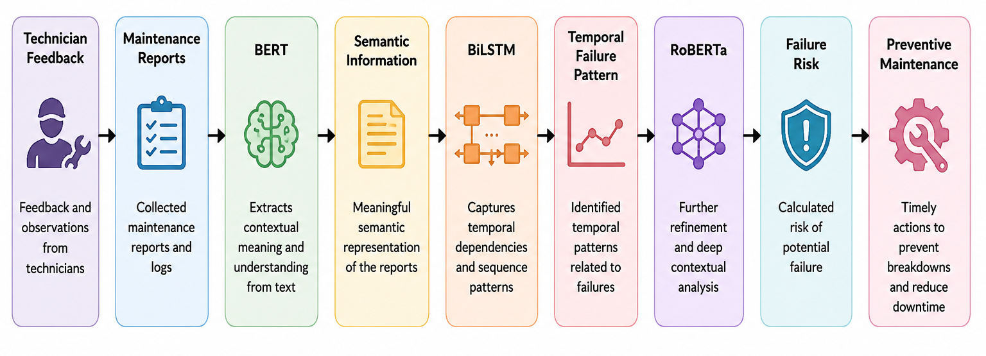
Overall Workflow
CAPSTONE PROJECT
12

Slide 13
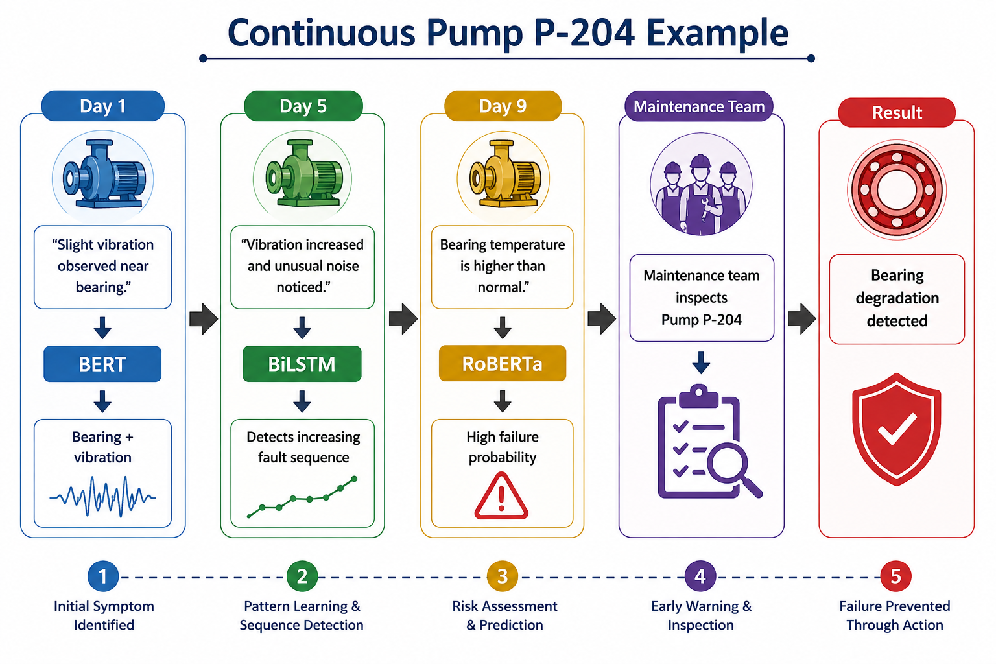
Workflow
CAPSTONE PROJECT
13

Slide 14
Comparison
Traditional Approach | Proposed NLP Approach
Mainly uses sensor data | Uses maintenance narratives
Focuses on numerical readings | Understands technician observations
Limited text analysis | Semantic text analysis
Individual events may be separated | Events are connected over time
Threshold-based warnings | NLP-based failure prediction
Limited use of technician knowledge | Utilizes maintenance experience
CAPSTONE PROJECT
14

Slide 15
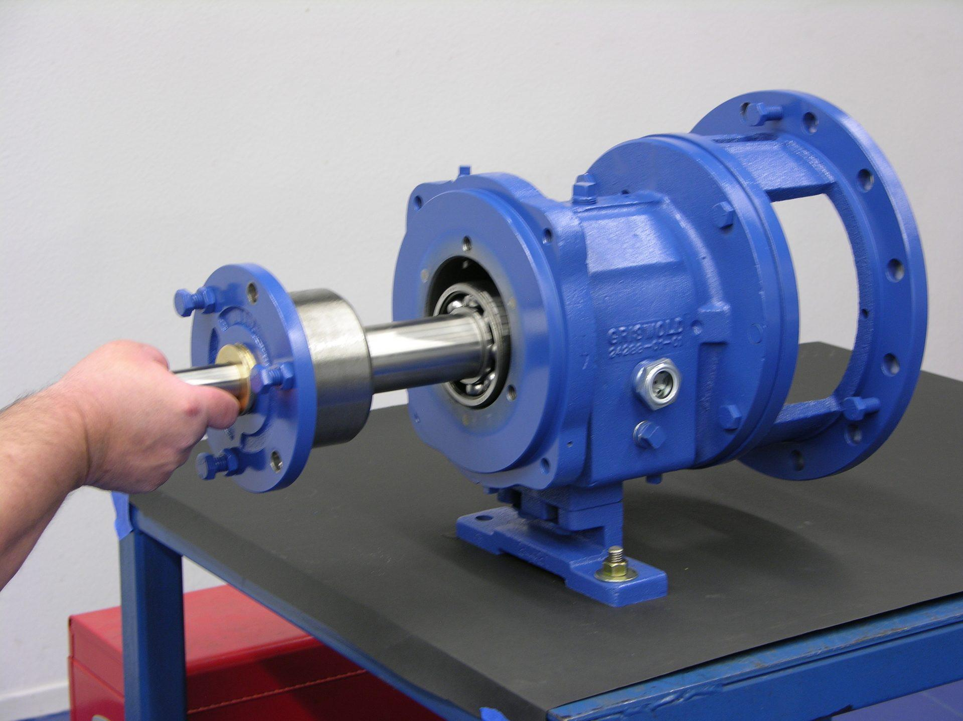
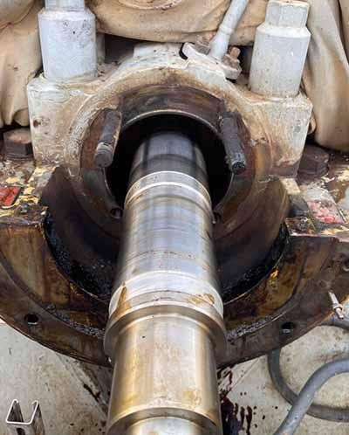
Results and Improvements
Identifies important failure information from maintenance reports.
Detects progressive patterns in technician observations.
Provides earlier identification of potential equipment failure.
Improves utilization of unstructured maintenance knowledge.
Can complement existing sensor-based prediction systems.
Performance can be measured using Precision, Recall, F1-score, ROC-AUC, and early-warning lead time.
CAPSTONE PROJECT
15

Slide 16
Conclusion
The project uses NLP to analyze industrial maintenance narratives.
BERT extracts meaningful information from technician feedback.
BiLSTM identifies failure progression through event sequences.
RoBERTa predicts the failure risk of the equipment.
The Pump P-204 example demonstrates how small observations can form a meaningful failure pattern.
The system can support maintenance teams with earlier failure warnings.
CAPSTONE PROJECT
16

Slide 17
Future Scope
Combine technician feedback with real-time sensor data.
Extend the system to multiple industrial machines.
Add automatic root-cause analysis.
Support multiple languages used by industrial technicians.
Integrate with existing maintenance management systems.
Use LLMs and RAG for advanced maintenance knowledge retrieval.
CAPSTONE PROJECT
17

